Slide 1
Object Oriented Analysis and Design

Slide 2

Modeling
◆ There are three important type of UML models:
1.Class Model 2.State Model 3.Interaction Model

Slide 3
Modeling
1) Class model
The class model describes the structure of the object, the relationship of one object with other objects, attributes and operations of the object.
The goal of the class model is to capture the concepts from the real worlds that are useful for your application
The class model is represented by the class diagrams. The classes in this diagrams define the attributes and operations of each object.

Slide 4
Modeling
2) State model
The state model is concerned operations of the object.
with the time and sequencing of the
On occurrence of the events the object change their state.
The state Model captures the control aspect of the system.
The state model is represented by State diagram. Each state diagram represents state and the event sequences.

Slide 5
Modeling
3) Interaction Model
Interaction model describes how one object collaborates with other in order to achieve behaviour of the system
The overall behaviour of the system can be represented with the help of state and interaction model.
The interaction model includes use case diagrams, sequence diagrams and Activity diagrams.
The use case diagrams show how to outsider actor interacts with the system to achieve functionality.
The sequence Diagram represents the objects that interact and the time sequence of their interaction
The activity Diagram represents flow of control among objects.

Slide 6
INTERACTION MODELING

Slide 7
Introduction
→The interaction model is the third leg of the modeling tripod and describes interactions within a system.
→The class model describes the objects in a system and their relationships.
→The interaction model describes how the objects interact.
→In this chapter we will discuss following diagrams:
1)Use Case diagram 2) Sequence diagram 3)Activity diagram

Slide 8
Use Case Models
◆ Use cases describe how a system interacts with outside actors.
◆ Each use case represents a piece of functionality that a system provides to its users.
Actors:
◆ An actor is a direct external user of a system.
◆ An object or set of objects that communicates directly with the system but that is not part of the system.
◆ Each actor represents those objects that behave in a particular way toward the system.

Slide 9
Use Case Models Continue…
◆ An actor is directly connected to the system and indirectly connected to the system is not called an actor.
the object
◆ In use case diagram actor is represented by following symbol.
Actor name

Slide 10
Use Cases
◆ A use case is a coherent piece of functionality that a system can provide by interacting with actors.
◆ For example a customer actor can buy a beverage from a vending machine.
◆ Following are the use cases for the vending machine.
Buy a beverage
Perform scheduled maintenance
Make repairs
Load items

Slide 11
Use Cases
◆ Each use case involves one or more actors as well as the system itself.
◆ The use case buy a beverage involves the customer actor and the use case perform scheduled maintenance involves the repair technician actor.
◆ In a telephone system the use case make a call involves two actors a caller and a receiver.
◆ The actors need not all be persons.

Slide 12
Include Relationship
◆
The include relationship could be used:
•
to simplify large use case by splitting it into several use cases,
•
to extract common parts of the behaviours of two or more use cases.
A large use case could have some behaviours which might be detached into distinct smaller use cases to be included back into the base use case using the UML include relationship. The purpose of this action is modularization of behaviours, making them more manageable.
•

Slide 13
Extend Relationship
Extend is a directed relationship that specifies how and when the behaviour defined in usually supplementary (optional) extending use case can be inserted into the behaviour defined in the extended use case.
▪
Extend relationship is shown as a dashed line with an open arrowhead directed from the extending use case to the extended (base) use case. The arrow is labelled with the keyword «extend».
▪
UML 80

Slide 14
Guidelines for Use case models
First determine the system boundary
Ensure that actors are focused
-Each actor should have a single purpose. If multiple purposes show them with separate actors.
Relate use cases and actors

Slide 15
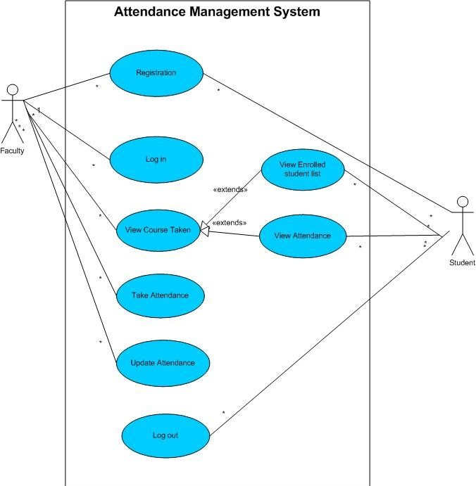
Attendance Management System

Slide 16
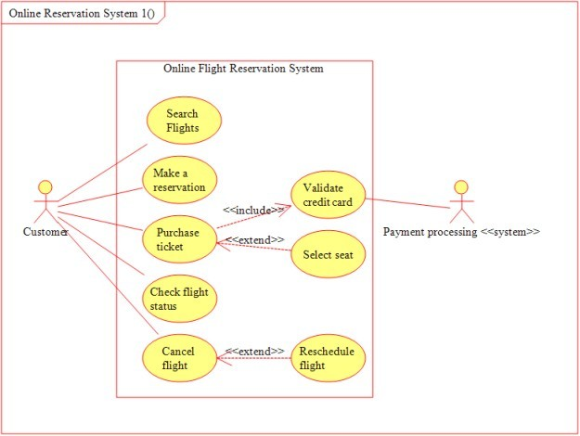
UML 84

Slide 17
Sequence Models
◆ A Sequence diagram is an interaction diagram that shows how processes operate with one another and in what order. A sequence diagram shows object interactions arranged in time sequence.
Key parts of a sequence diag.
1) participant: an object or entity that acts in the sequence diagram
◆ sequence diagram starts with an unattached "found message" arrow

Slide 18
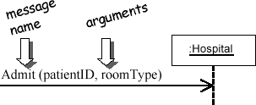
Key parts of a sequence diag
2) message: communication between participant objects the axes in a sequence diagram:
◆ horizontal: which object/participant is acting
◆ vertical: time (down -> forward in time)
◆ message (method call) indicated by horizontal arrow to other object
◆ write message name and arguments above arrow
UML 86

Slide 19
Key parts of a sequence diag
3) Focus of control (execution occurrence):
An execution occurrence (shown as tall, thin rectangle on a lifeline) represents the period during which an element is performing an operation.
The top and the bottom of the of the rectangle are aligned with the initiation and the completion time respectively.

Slide 20
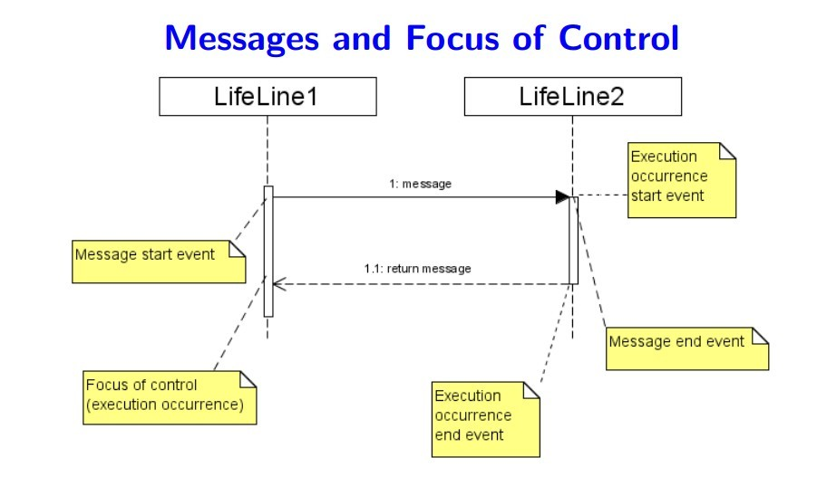
Key parts of a sequence diag.
4) Lifeline: squares with object type, optionally preceded by object name and colon
◆ write object's name if it clarifies the diagram
◆ object's "life line" represented by dashed vert. line

Slide 21
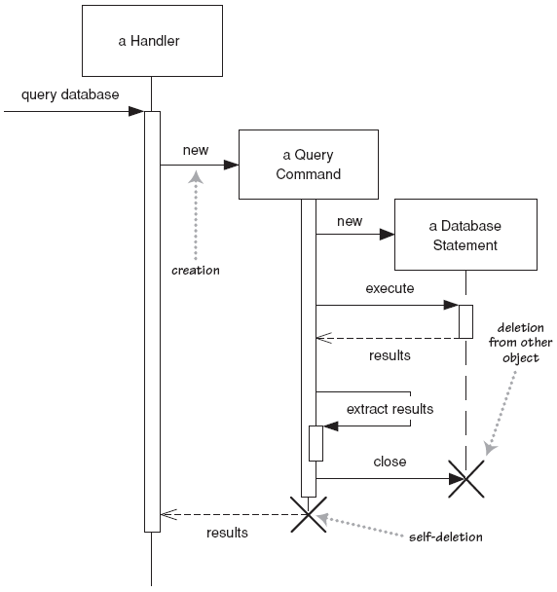
Lifetime of objects
◆ creation: arrow with 'new' written above it
◆ notice that an object created after the start of the scenario appears lower than the others
◆ deletion: an X at bottom of object's lifeline

Slide 22
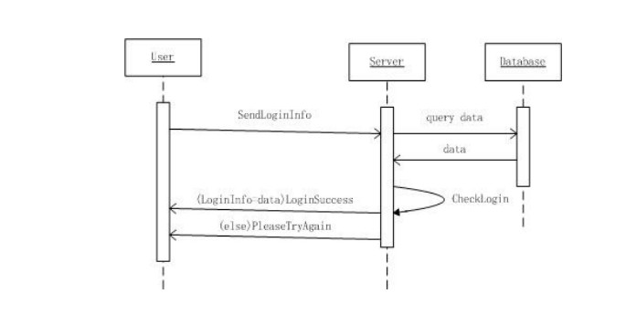
Scenarios for AMS
◆ Each scenario has a sequence of steps.
Scenario 1 : Log in

Slide 23
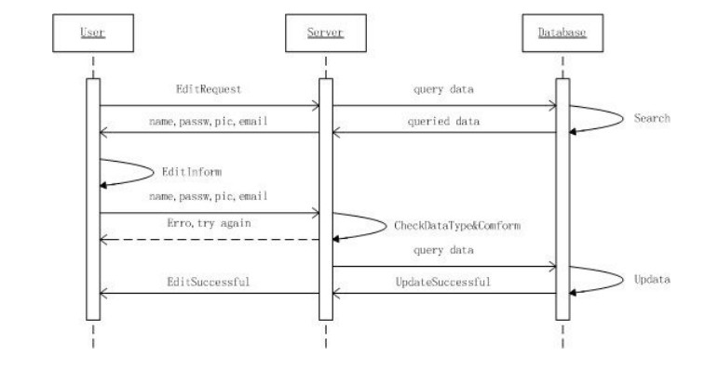
Scenarios for AMS
◆ Scenario 2 : Update Student or faculty profile.

Slide 24
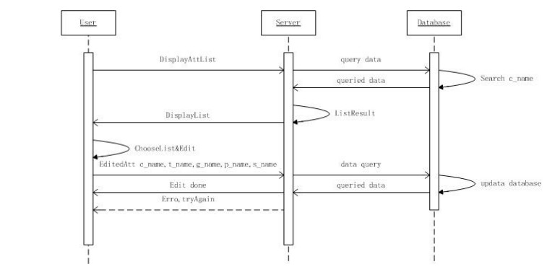
Scenarios for AMS
◆ Scenario 3 : Update Attendance

Slide 25
Guidelines for Sequence Models
◆ Prepare at least one scenario per use case:
◆ Abstract the scenarios into sequence diagrams: The seq. diagram clearly show the contribution of each actor.
◆ Divide complex interaction:
◆ Prepare a sequence diagram for each error condition.

Slide 26
Activity Diagrams
•
•
Useful to specify software or hardware system behaviour
Based on data flow models – a graphical representation (with a Directed Graph) of how data move around an information system

Slide 27
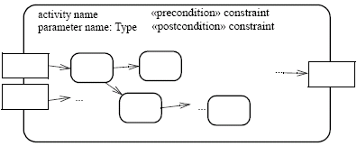
Activities
An activity is the specification of parameterized behaviour as the coordinated sequencing of subordinate units whose individual elements are actions
•
•
Uses parameters to receive and provide data to the invoker
Activity nodes
Paramet er name
Paramet er name
Activity edges
Output paramete r
Input paramete r
Paramet er name

Slide 28


Activity nodes
◆ Three type of activity nodes:
◆ Action nodes: executable activity nodes; the execution of an action represents some transformations or processes in the modeled system (already seen)
◆ Control nodes: coordinate flows in an activity diagram between other nodes

Slide 29
Forking and Joining
Use a synchronization bar to specify the forking and joining of parallel flows of control
•
A synchronization bar is rendered as a thick horizontal or vertical line.
Fork-A fork may have one incoming transitions and two or more outgoing transitions
each transition represents an independent flow of control
conceptually, the activities of each of outgoing transitions are concurrent either truly concurrent (multiple nodes) or sequential yet interleaved (one node)

Slide 30
Forking and Joining(Cont’d)
◆ A join may have two or more incoming transitions and one outgoing transition above the join, the activities associated with each of these paths continues in parallel at the join, the concurrent flows synchronize
◆ Each waits until all incoming flows have reached the join, at which point one flow of control continues on below the join

Slide 31
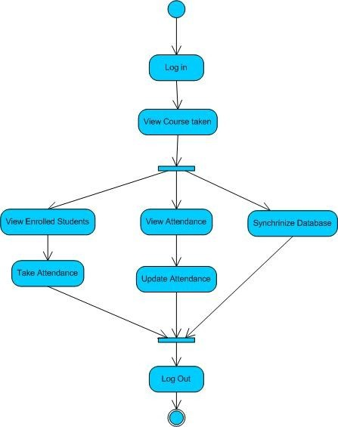
Activity Diagram of Attendance Management System

